Slide 2
X-Ray Diffraction
(XRD)
X-Ray Photoelectron Spectroscopy
(XPS)
By: Roya Ayazi Nasrabadi

Slide 3
What is X-ray?

Slide 5
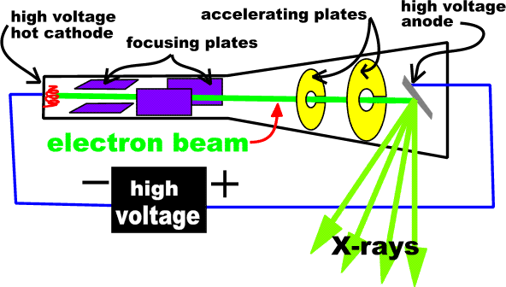

Slide 6
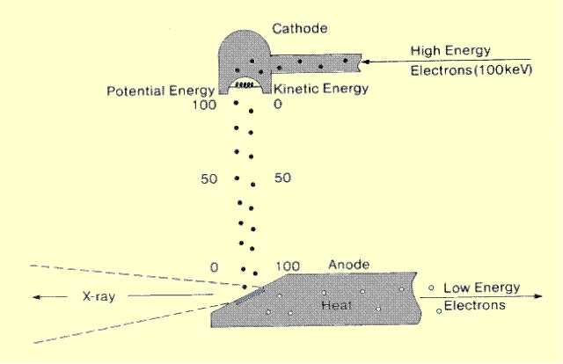

Slide 8
X-ray diffraction
(XRD)

Slide 9
Bragg’s Law
n λ=2dsinθ
English physicists Sir W.H. Bragg and his son Sir W.L. Bragg developed a relationship in 1913 to explain why the cleavage faces of crystals appear to reflect X-ray beams at certain angles of incidence (theta, q). The variable d is the distance between atomic layers in a crystal, and the variable lambda l is the wavelength of the incident X-ray beam; n is an integer. This observation is an example of X-ray wave interference (Roentgenstrahlinterferenzen), commonly known as X-ray diffraction (XRD), and was direct evidence for the periodic atomic structure of crystals postulated for several centuries. Although Bragg's law was used to explain the interference pattern of X-rays scattered by crystals, diffraction has been developed to study the structure of all states of matter with any beam, e.g., ions, electrons, neutrons, and protons, with a wavelength similar to the distance between the atomic or molecular structures of interest.

Slide 10
BRAGG’s EQUATION
Deviation = 2θ
Ray 1
Ray 2
θ
θ
θ
θ
θ
d
dSinθ
The path difference between ray 1 and ray 2 = 2d Sinθ
For constructive interference: nλ = 2d Sinθ

Slide 11
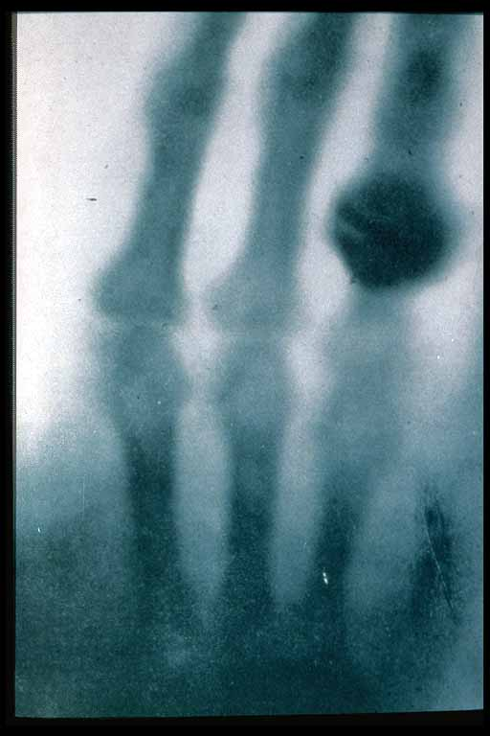
History of X-Ray Diffraction
1895 X-rays discovered by Roentgen
1914 First diffraction pattern of a crystal made by Knipping and von Laue
1915 Theory to determine crystal structure from diffraction pattern developed by Bragg.
1953 DNA structure solved by Watson and Crick
Now Diffraction improved by computer technology; methods used to determine atomic structures and in medical applications
The first X-ray

Slide 12
What is X-ray Diffraction ?
X-Ray Diffraction (XRD) is a high-tech, non-destructive technique for analyzing a wide range of materials, including fluids, metals, minerals, polymers, catalysts, plastics, pharmaceuticals, ceramics, solar cells and semiconductors.

Slide 13
Traditional methods of analysis such as:
Atomic Adsorption,
Mass Spec,
Chromatography,
Infra-red spectroscopy,
UV-Vis spectroscopy etc require dissolution into a fluid phase: destructive
Materials or solids analysis has been driven by the requirement to produce
non-destructive methods.
They can be described in six categories:-
Elemental – the atoms present – XRF, EDX
Structural – define atomic arrangement - XRD
Chemical – define the chemical state - XPS
Imaging – what does the morphology look like? – Electron Microscopy
Spectroscopic – energy level transitions – IR
Thermal – effects of heating (sorption) – TGA, DSC
Problems:- Destructive
Elemental
No understanding of their form in the material

Slide 14
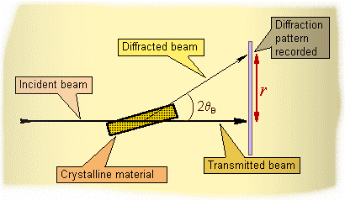
www.micro.magnet.fsu.edu/primer/java/interference/index.html

Slide 15
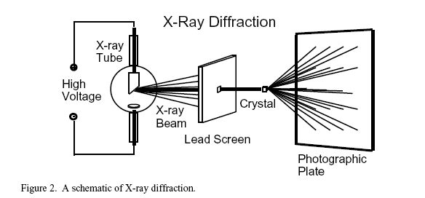
How Diffraction Works: Schematic
NaCl
http://mrsec.wisc.edu/edetc/modules/xray/X-raystm.pdf

Slide 16
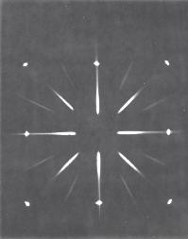
NaCl
http://mrsec.wisc.edu/edetc/modules/xray/X-raystm.pdf

Slide 18
Why XRD?
Measure the average spacings between layers or rows of atoms
Determine the orientation of a single crystal or grain
Find the crystal structure of an unknown material
Measure the size, shape and internal stress of small crystalline regions
The method of XRD relationship with the use of ambition can be special conditions in the seed as much as you determined tailoring.
The diagnosis of phases and inserted into their position
Measure a thin layer films and multilayer

Slide 19
Diffraction measurements
1. Qualitative measurement
Network computing unit and search databases to find the combination of crystal unit with the same network or the like. Application of this method is so simple, but there need to reference patterns in the database has no phase.
PDF2-ICDD Comparison of the measured diffraction pattern with diffraction pattern in the reference database PDF2-ICDD
Quantitative analysis methods
Reference intensity ratio (RIR) Based on intensity powerful than the strongest line in the sample reference in the mixed phase line 1:1
Add internal standard
Rytvld method (Reitveld)

Slide 22
Crystal
Schematic of difference between the diffraction patterns of various phases
Intensity →
0
90
180
Diffraction angle (2θ) →
Monoatomic gas
Intensity →
Diffraction angle (2θ) →
Diffraction angle (2θ) →
Liquid / Amorphous solid
Intensity →
0
90
180
0
90
180

Slide 24
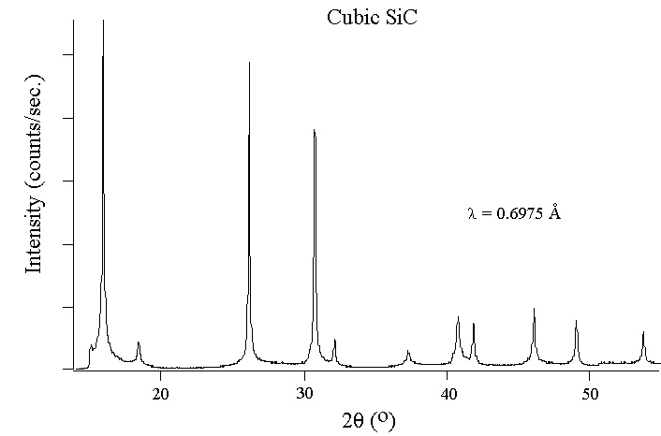
Analyzing Diffraction Patterns
d1=1.09 A
d2=1.54 A
http://www.ecn.purdue.edu/WBG/Introduction/
http://www.eserc.stonybrook.edu/ProjectJava/Bragg/

Slide 25
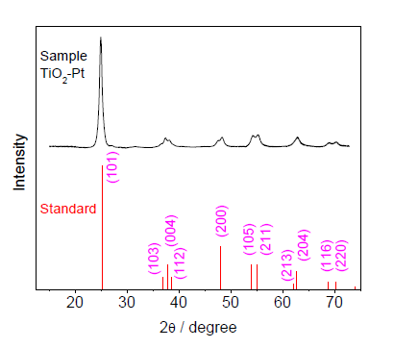
XRD patterns for the standard values of JCPDS No.21-1272 and TiO2-Pt nanofibers obtained by calcining Pt(OAc)2-TiO2-PVP nanofibers in air at 500 °C for 3h.

Slide 26
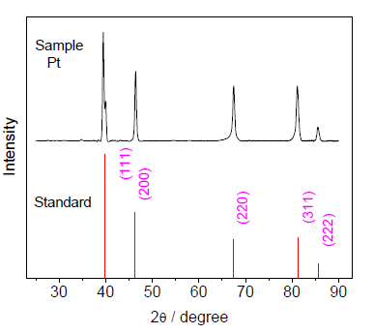
XRD patterns for the standard values of JCPDS No.04-0802 and Pt obtained by calcining Pt(OAc)2-PVP nanofibers in air at 500 °C for 3 h.

Slide 27
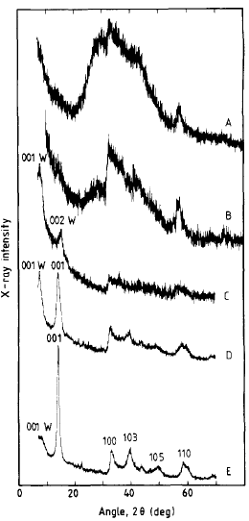
A study of single-layer and restacked MoS, by x-ray diffraction and x-ray absorption spectroscopy
X-ray diffraction patterns for: single layers of MoS, in suspension in water (curve A), a mix of single-layer MoS2 and MoS2 with a water bilayer between the layers (curve B), MoS, with a water bilayer (curve C), a mix of MoS, with a water bilayer and dry restacked MoS, (curve D), and mostly dry restacked MoS2 (curve E).

Slide 28
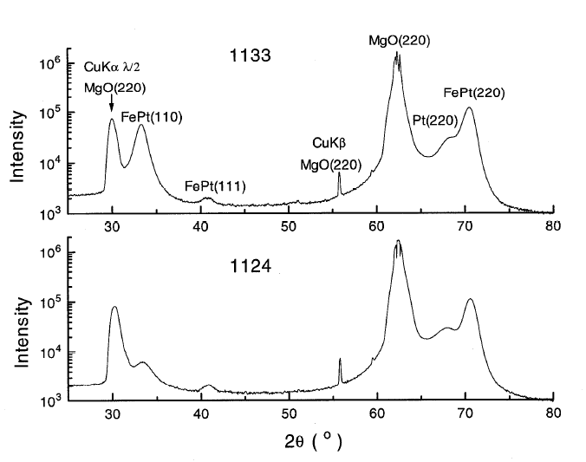
Conventional XRD patterns for the 1133 film (top) and the 1124 film (bottom) recorded
with the pulse height analyzer (PHA) set at base = 1.0 and window = 4.5 volts.
JCPDS International Centre for Diffraction Data 1999

Slide 29
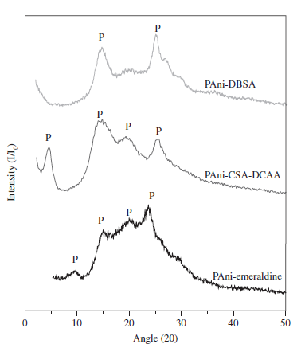
Polyaniline and Mineral Clay-based Conductive Composites
XRD patterns of PAni synthesized under different processing conditions.

Slide 30
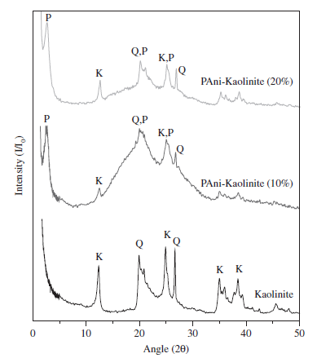
XRD patterns of kaolinite and composites synthesized with different amounts of mineral clay.

Slide 31
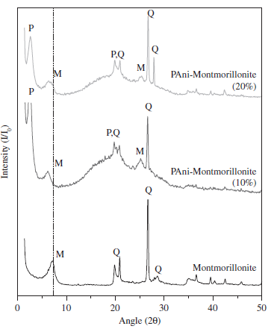
XRD patterns of montmorillonite and composites synthesized with different amounts of mineral clay.
Materials Research, Vol. 10, No. 3, 297-300, 2007

Slide 32
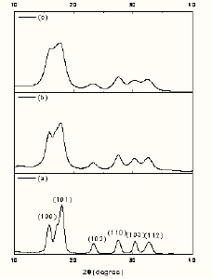
Synthesis and Characterization of ZnO Nanoparticles and Nanorods with Various Morphologies
Powder X-ray diffraction spectra of ZnO nanoparticles with (a) [LiOH]/[Zn(OAc)2] = 1.4 (b) [LiOH]/[Zn(OAc)2] = 2.8 (c) [LiOH]/[Zn(OAc)2] = 3.3.

Slide 33
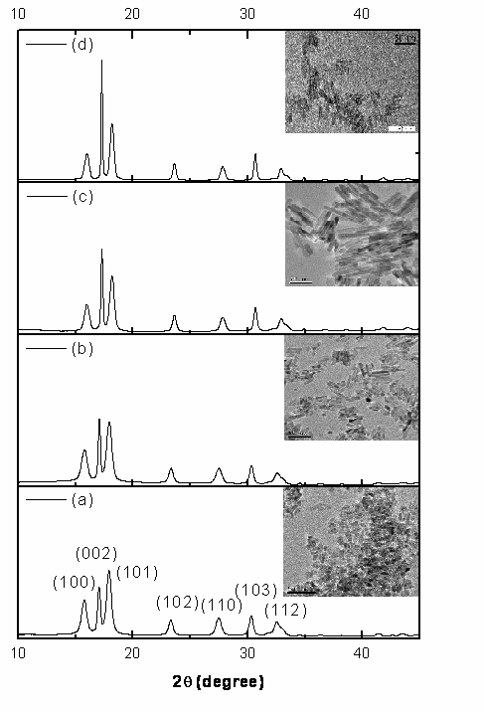
Powder X-ray diffraction spectra and TEM images of ZnO nanorods prepared under different conditions: (a) 60 ℃ for 5 h; (b) 60 ℃ for 12 h; (c) 60 ℃ for 24 h; (d) 60 ℃ for 48 h.

Slide 34
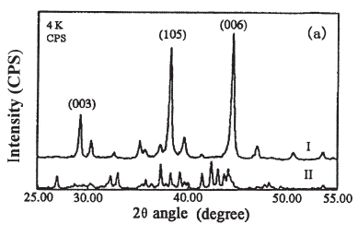
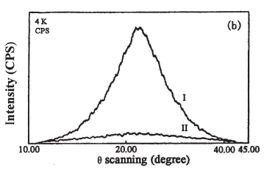
Crystal Orientation Measured by XRD and Annotation of the Butterfly Diagram
Conventional XRD pattern from a specimen of Nd2Fe14B
Crystal Orientation Measured by XRD, Elsevier Science Inc., 2000. All rights reserved

Slide 35
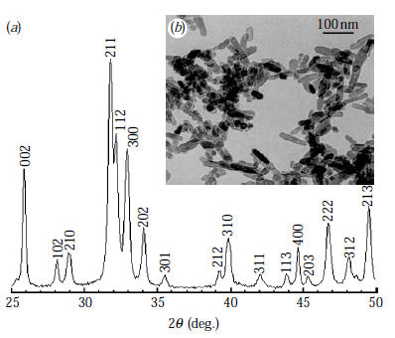
Novel patterning of nano-bioceramics:
template-assisted electrohydrodynamic
atomization spraying
(a) X-ray diffraction pattern and (b) transmission
electron micrograph of the nHA synthesized.
J. R. Soc. Interface (2008) 5, 253–257

Slide 36
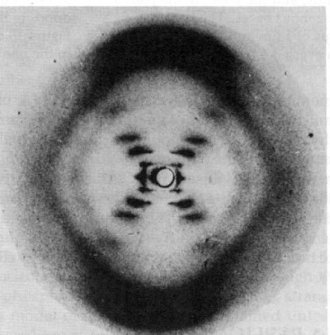
Solving the Structure of DNA
Photo 51 Analysis
“X” pattern characteristic of helix
Diamond shapes indicate long, extended molecules
Smear spacing reveals distance between repeating structures
Missing smears indicate interference from second helix
Photo 51- The x-ray diffraction image that allowed Watson and Crick to solve the structure of DNA
www.pbs.org/wgbh/nova/photo51

Slide 37
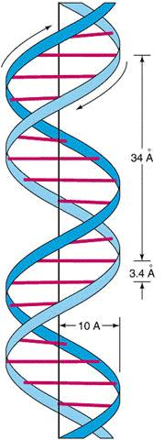
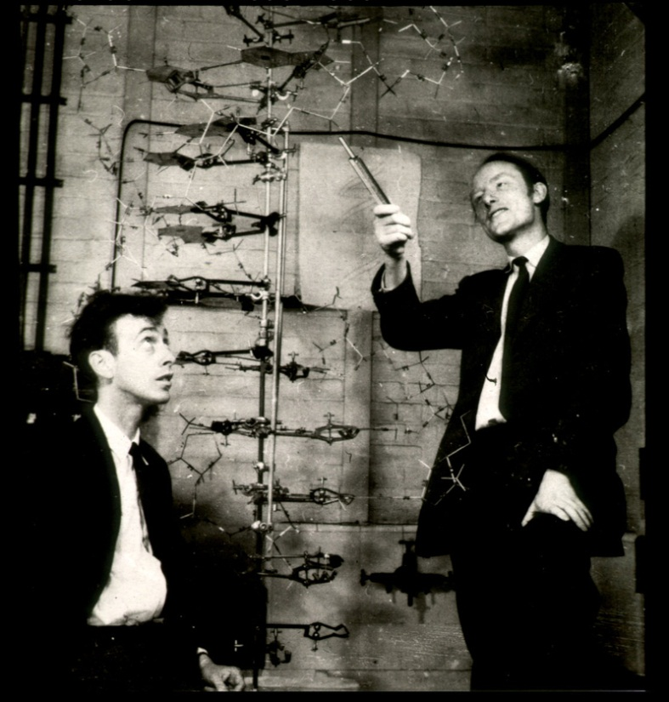
Solving the Structure of DNA
Information Gained from Photo 51
Double Helix
Radius: 10 angstroms
Distance between bases: 3.4 angstroms
Distance per turn: 34 angstroms
Combining Data with Other Information
DNA made from:
sugar phosphates
4 nucleotides (A,C,G,T)
Chargaff’s Rules
%A=%T
%G=%C
Molecular Modeling
Watson and Crick’s model

Slide 38
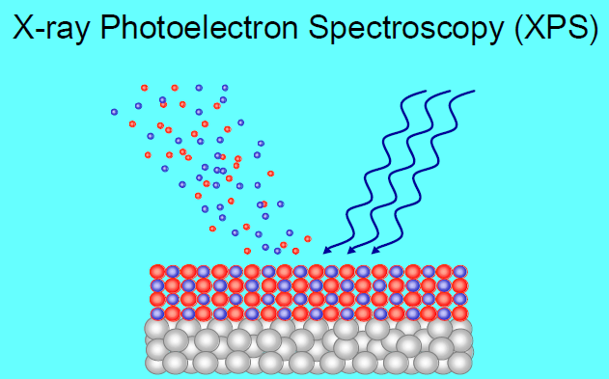

Slide 39
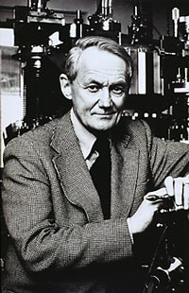
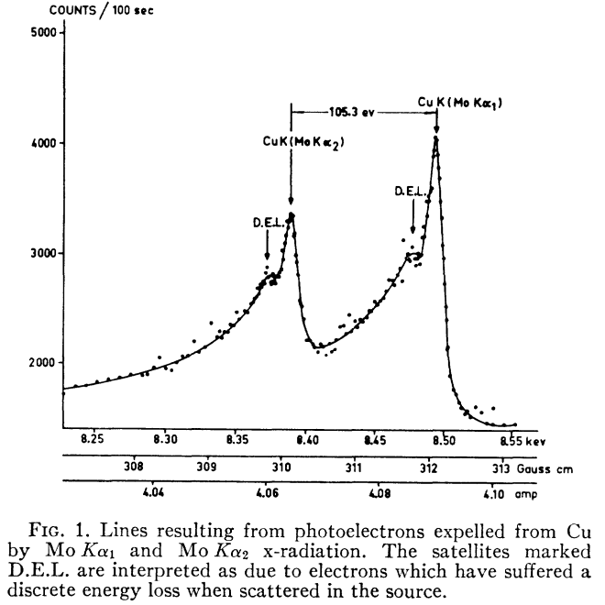
Kai Seigbahn: Development of X-ray Photoelectron Spectroscopy
C. Nordling E. Sokolowski and K. Siegbahn, Phys. Rev. 1957, 105, 1676.
Nobel Prize in Physics 1981
(His father, Manne Siegbahn, won the Nobel Prize in Physics in 1924
for the development of X-ray spectroscopy)

Slide 40
X-ray Photoelectron Spectroscopy (XPS)
X-ray photoelectron spectroscopy (XPS, also called electron spectroscopy for chemical analysis, ESCA)
X-ray photoelectron spectroscopy works by irradiating a sample material with monoenergetic soft x-rays causing electrons to be ejected.
Identification of the elements in the sample can be made directly from the kinetic energies of these ejected photoelectrons.
The relative concentrations of elements can be determined from the photoelectron intensities.

Slide 41
Instrumentation
XPS instruments consist of an x-ray source, an energy analyzer for the photoelectrons, and an electron detector. The analysis and detection of photoelectrons requires that the sample be placed in a high-vacuum chamber. Since the photoelectron energy depends on x-ray energy, the excitation source must be monochromatic. The energy of the photoelectrons is analyzed by an electrostatic analyzer, and the photoelectrons are detected by an electron multiplier tube or a multichannel detector such as a microchannel plate.

Slide 42
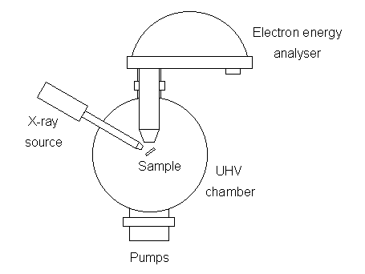
Schematic diagram of a XPS system

Slide 43
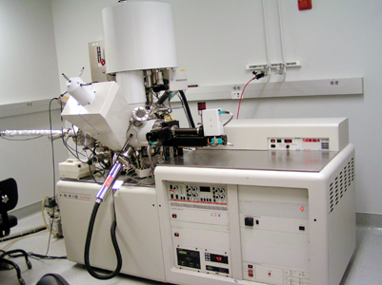

Slide 44
Basic principles
The relationship governing the interaction of a
photon with a core level is:
E_{kin} = kinetic energy of ejected photoelectron
hν = characteristic energy of X-ray photon
E_{B} = binding energy of of the atomic orbital
from which the electron originates.
Φ= spectrometer work function

Slide 45
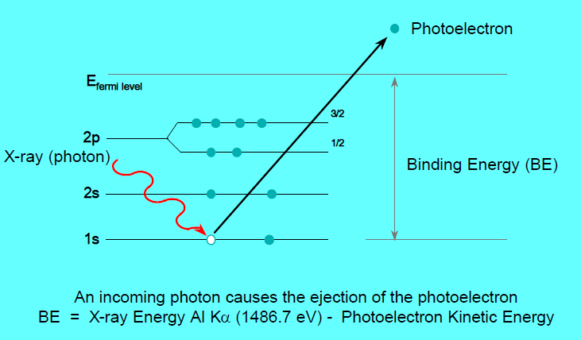
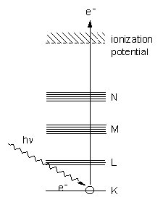

Slide 46
XPS is used to measure
elemental composition of the surface (top 1–10 nm usually)
empirical formula of pure materials
elements that contaminate a surface
chemical or electronic state of each element in the surface
uniformity of elemental composition across the top surface (or line profiling or mapping)
uniformity of elemental composition as a function of ion beam etching (or depth profiling)

Slide 47
Materials routinely analyzed by XPS
Inorganic compounds, metal alloys, semiconductors, polymers, pure elements, catalysts, glasses, ceramics, paints, papers, inks, biomaterials, viscous oils, glues, ion modified materials.
Organic chemicals are not routinely analyzed by XPS because they are readily degraded by either the energy of the X-rays or the heat from non-monochromatic X-ray sources.

Slide 48
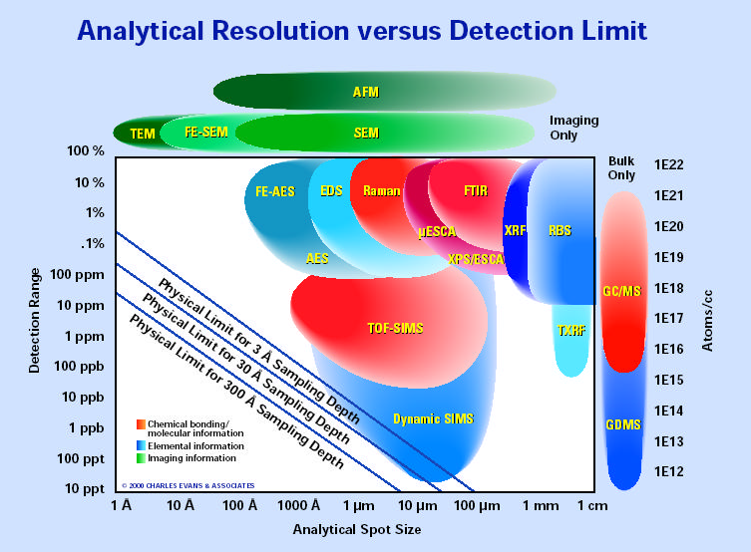

Slide 49
Practical applications

Slide 51
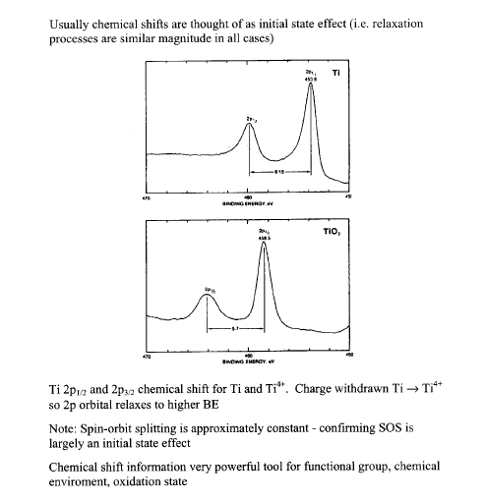

Slide 52
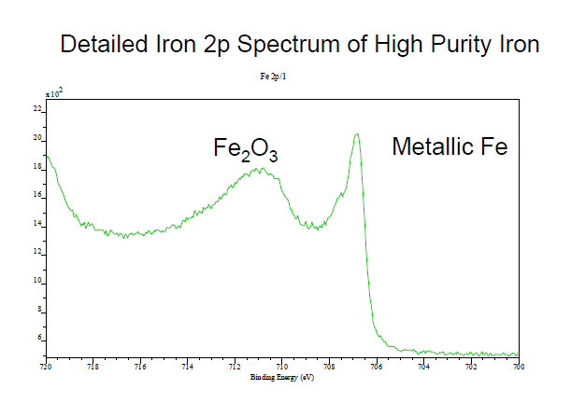

Slide 53
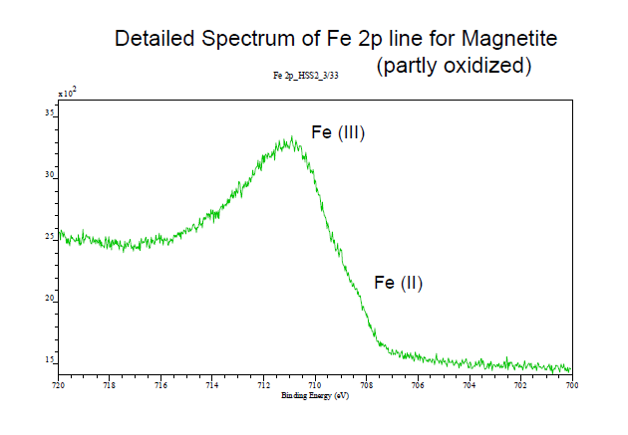

Slide 55
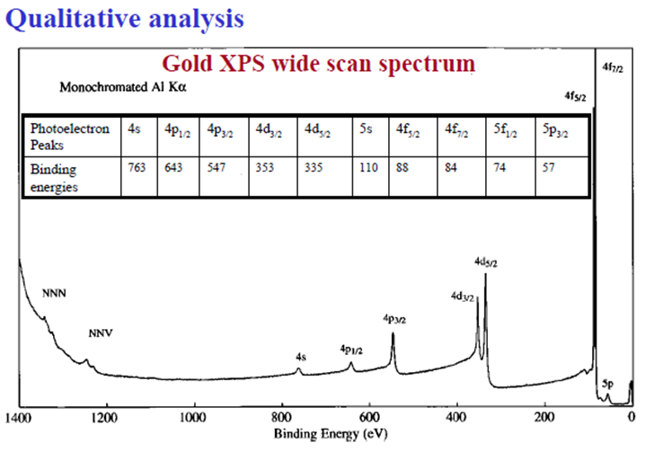

Slide 56
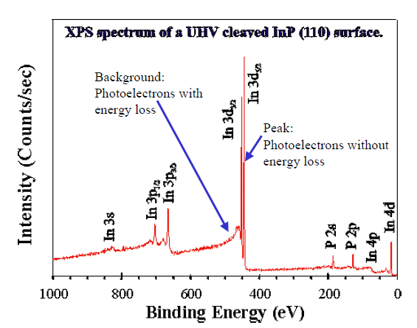

Slide 57
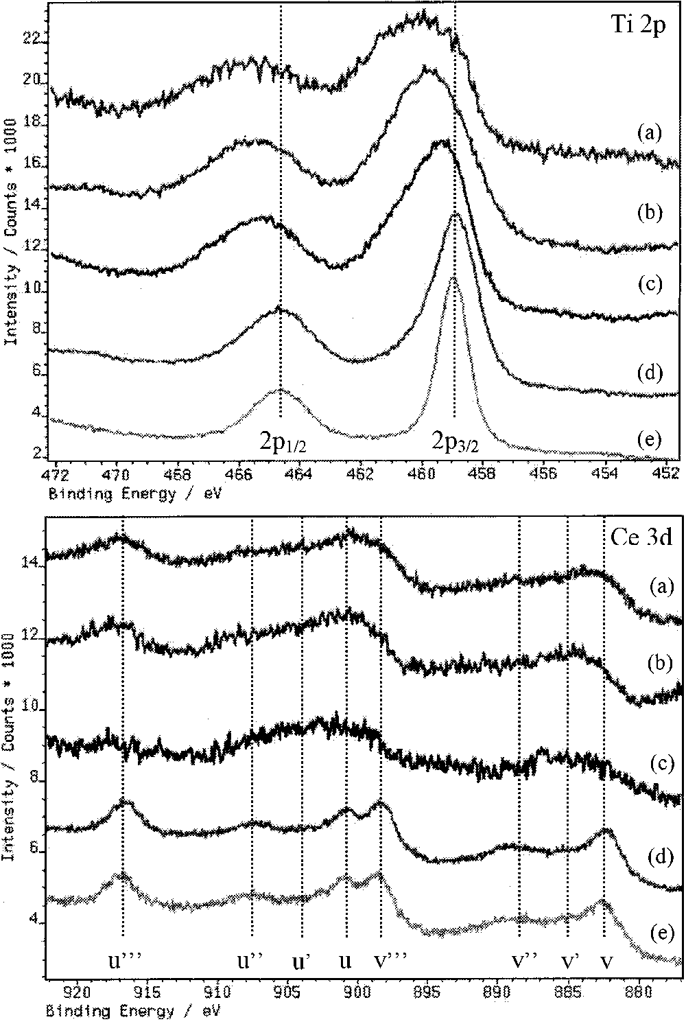
X-ray photoelectron spectroscopy, x-ray absorption spectroscopy, and x-ray diffraction characterization of CuO– TiO2–CeO2 catalyst system
J. Vac. Sci. Technol. A 19.4., Jul/Aug 2001

Slide 58
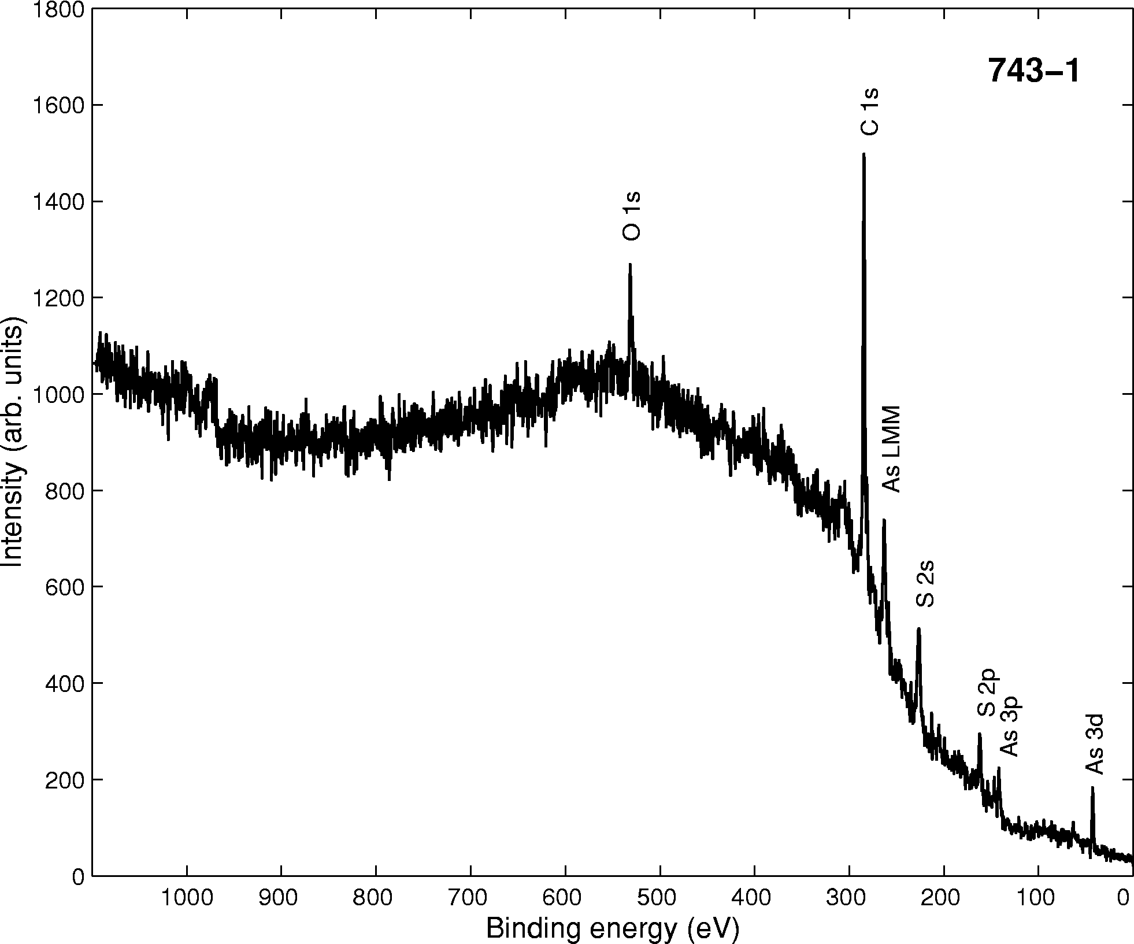
survey
Surface Science Spectra, Vol. 9, 2002

Slide 59
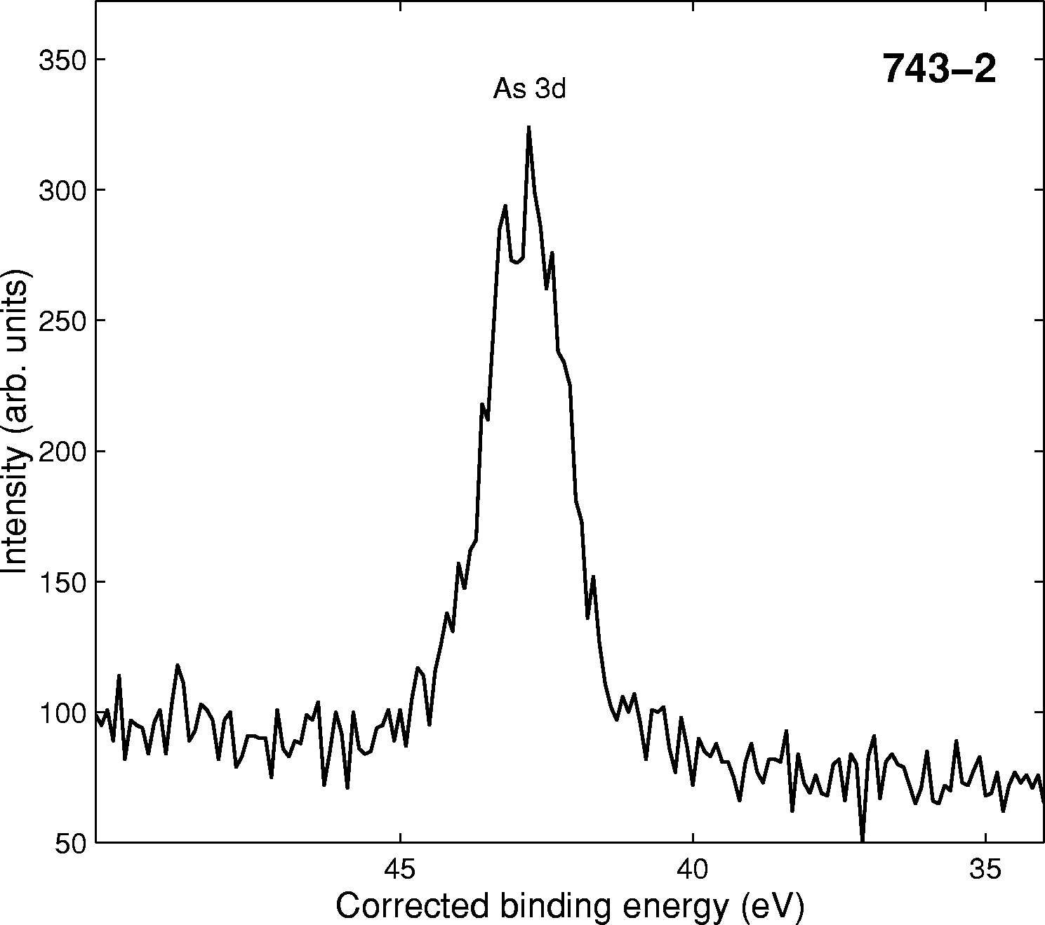
As 3d

Slide 60
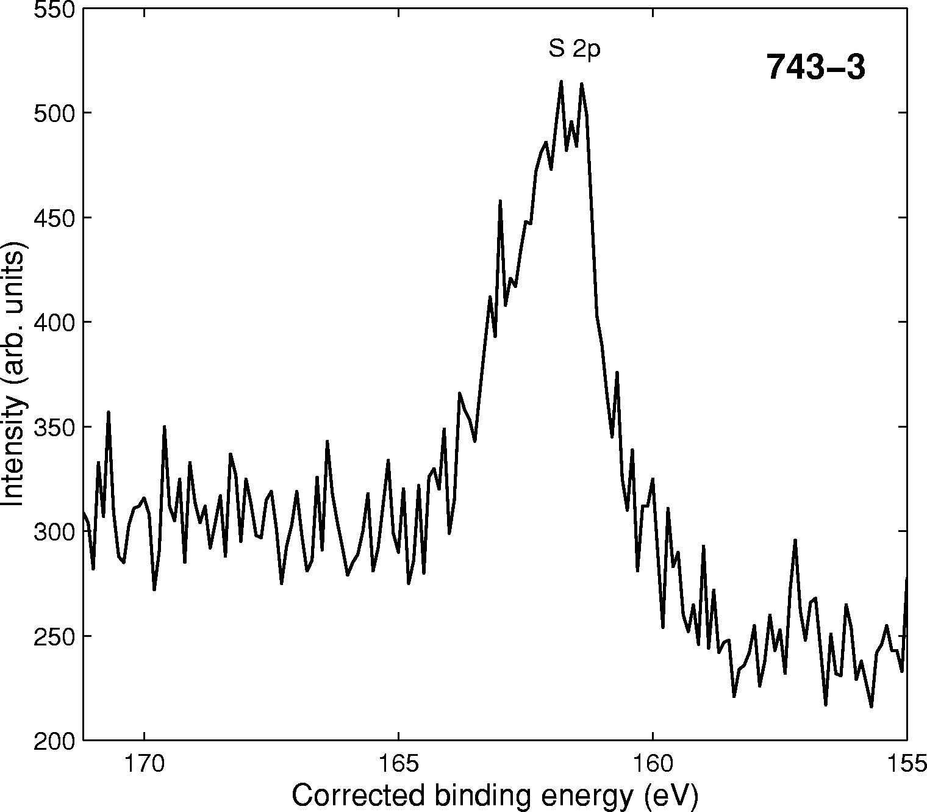
S 2p

Slide 61
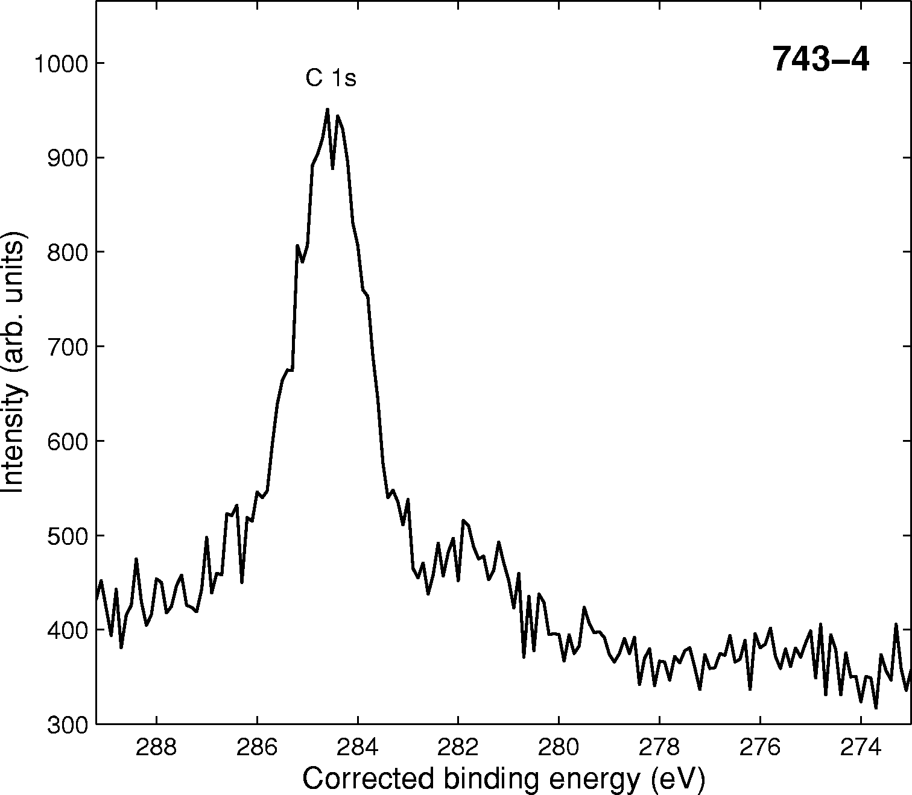
C 1s

Slide 62
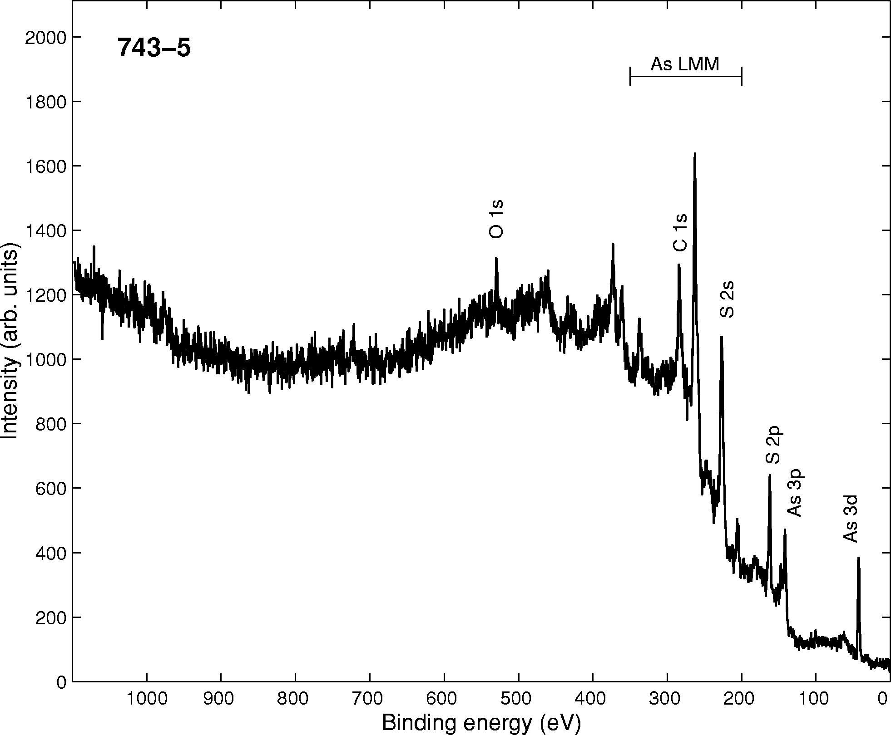
survey

Slide 63
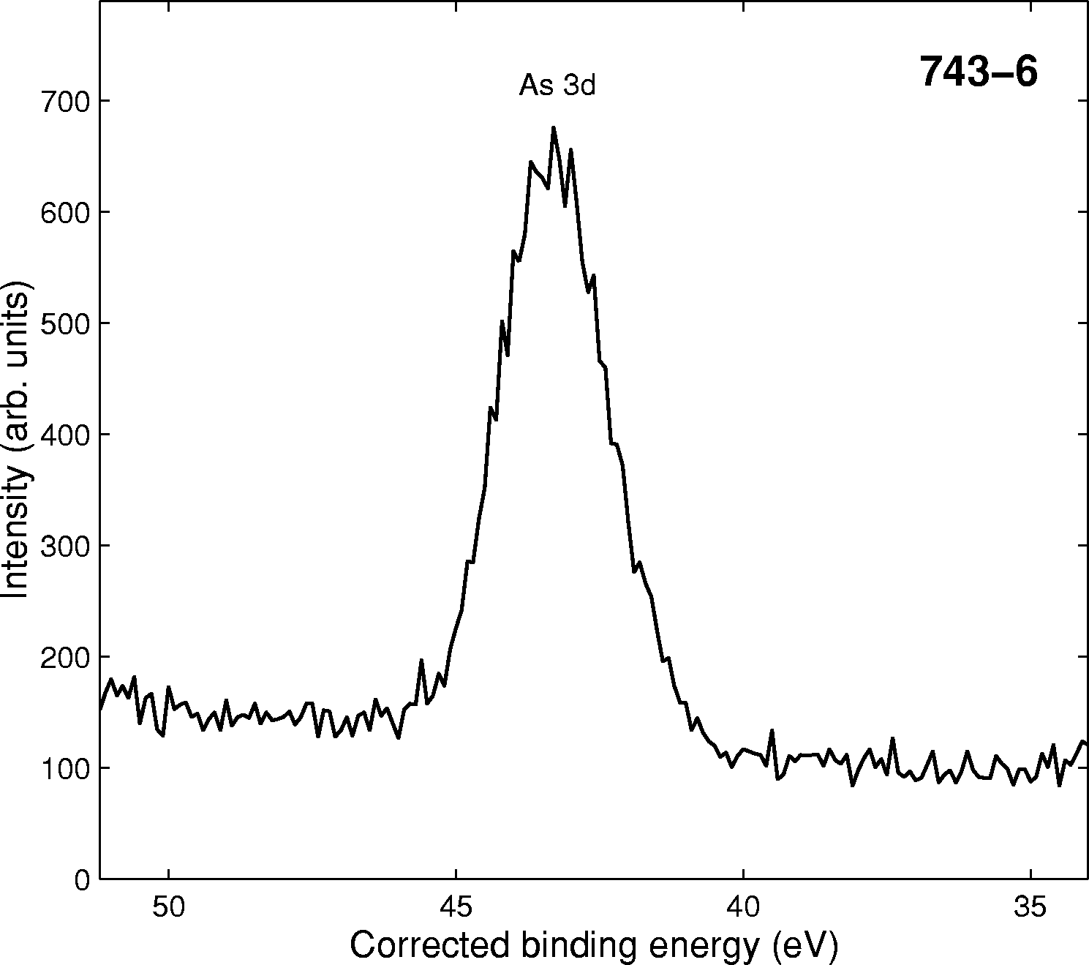
S 2p

Slide 64
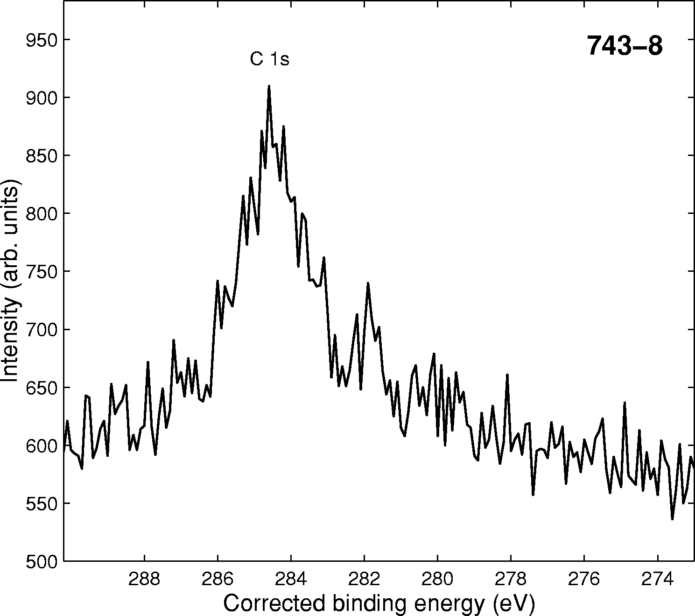
C 1s

Slide 65
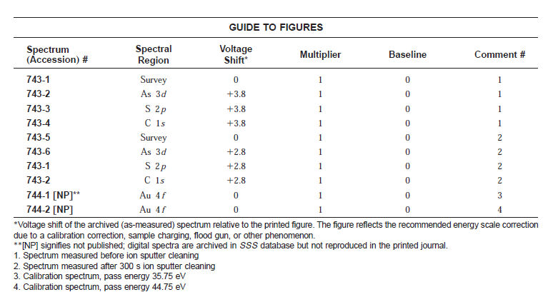

Slide 66
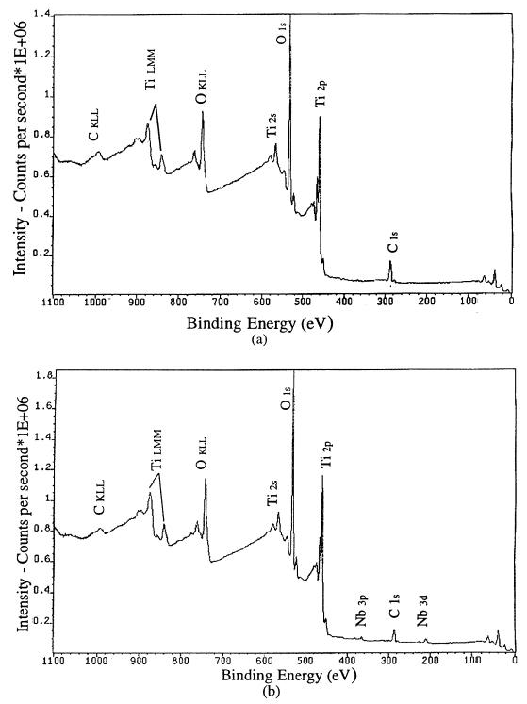
XPS Applications in Thin Films Research
XPS survey spectra for the surfaces of (a) undoped and (b) doped TiO2 film on silicon
wafer 7.

Slide 67
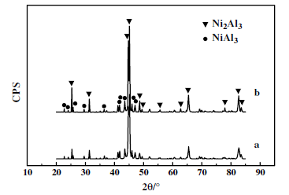
XRD and XPS studies on the ultra-uniform Raney-Ni catalyst prepared from the melt-quenching alloy
The XRD patterns of parent alloys: (a) Ni–Al alloys obtained by melt-quenching; (b) hydrogen-pretreated Ni–Al alloys obtained by melt-quenching.

Slide 68
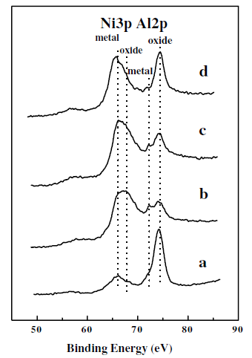
The Ni 3p/Al 2p XPS spectra of: (a) Ni–Al alloys obtained by melt-quenching; (b) sample (a) after leaching with NaOH; (c) sample (b) heated up to 200 °C for 10 min in a vacuum; (d) sample (b) heated up to 600 °C for 10min in a
vacuum.

Slide 69
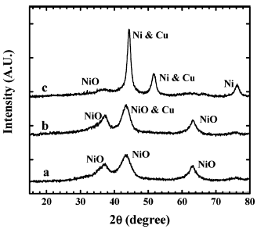
XRD and XPS Study of Cu-Ni Interactions on Reduced
Copper-Nickel-Aluminum Oxide Solid Solution Catalysts
XRD patterns of sample B1.8 reduced at (a) 270 °C, (b) 450 °C, and (c) 700 °C.

Slide 70
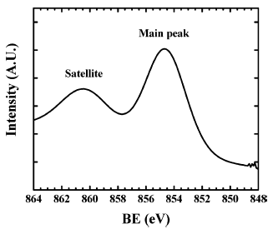
As-received bulk Ni 2p3/2 XPS spectrum

Slide 71
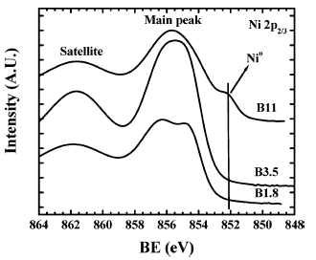
Ni 2p3/2 XPS spectra of samples B1.8, B3.5, and B11 reduced at 270 °C.

Slide 72
با تشکر
72

