Slide 1

IN THE NAME OF GOD
here
Provider:M.Kohi

Slide 2
IN THE NAME OF GOD
Introduction to Luminescence
April 2017

Slide 3
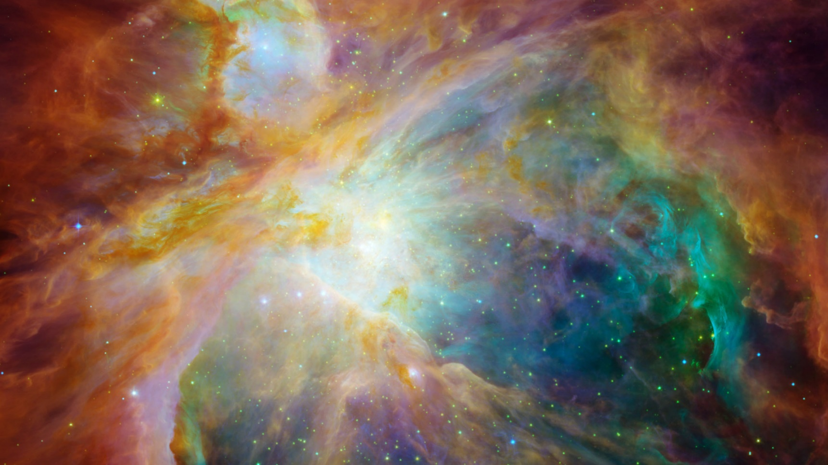
Spontaneous emission of radiation from an electronically excited species or from a vibrationally excited species not in thermal equilibrium with its environment.
Luminescence
The ﬁrst introduced of luminescenz was by the physicist and science historian Eilhardt Wiedemann in 1888 .
Comes from the Latin
(lumen= light)
Molecular Fluorescence: Principles and Applications, Second Edition. Bernard Valeur, Mário Nuno Berberan-Santos. Wiley-VCH, 2012
1

Slide 4
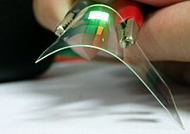
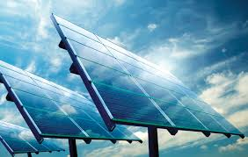
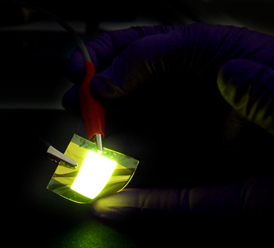
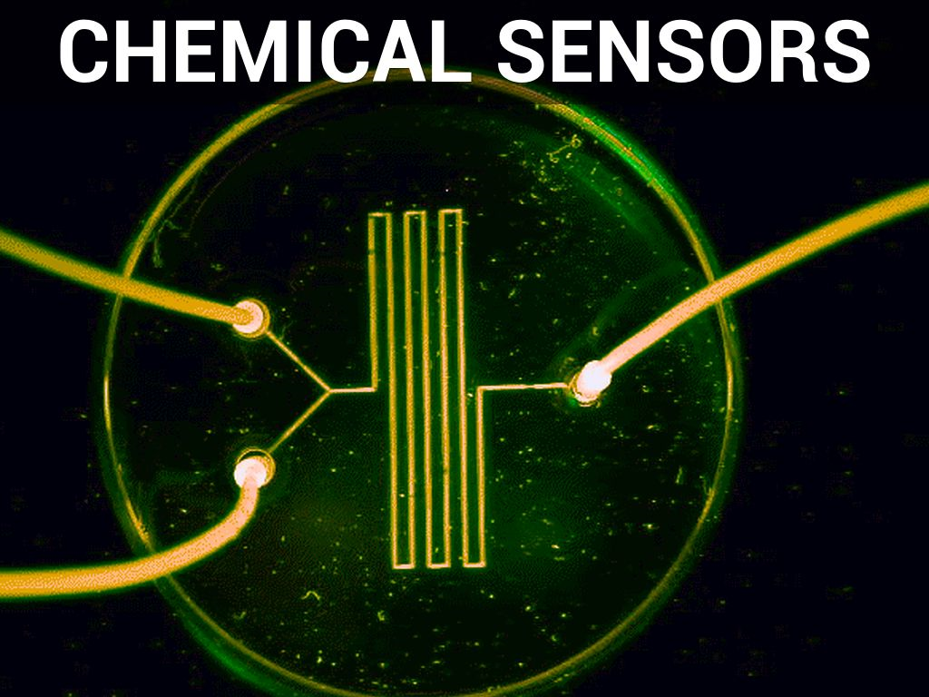
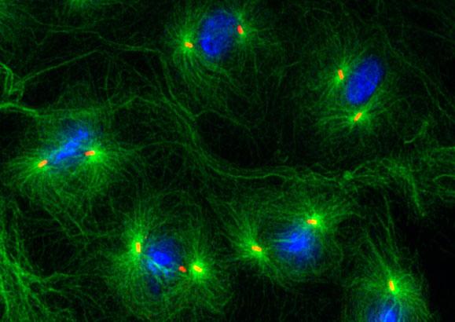
Applications :
1- Organic light-emitting diodes (OLEDs)
2- Light-emitting electrochemical cells
3- Photovoltaic cells
4- Chemical sensors
5- Bio-imaging
Chem. Soc. Rev., 2013,42, 6128-6185
2

Slide 5
Position of photoluminescence in the frame of light– matter interactions
Light-matter interactions
Scattering
Absorption
Ionization
Spontaneous emission
Stimulated emission
Fluorescence
Photoluminescence Electroluminescence Thermoluminescence Chemiluminescence Bioluminescence
etc.
Luminescence
Phosphorescence
Produced by the passage of an electric current through an ionized gas
the re-emission of absorbed energy when a substance is heated
Derives its energy from chemical reactions. It is the breaking of chemical bonds that supplies the energy.
A result of biochemical reactions in a living organism
3

Slide 6
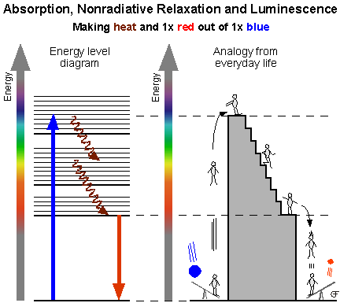
4

Slide 7
Photoluminescence (PL) :
A spinforbidden transition, occurs during relaxation of an electron from the triplet excited state to the ground state
(T₁ - S₀),
Phosphorescence(P)
Fluorescence (F)
A radiative transition between electronic states of the same multiplicity (S₁ - S₀).
Spontaneous emission following absorption of electromagnetic radiation of an appropriate frequency in the UV/visible region.
Chem. Soc. Rev., 2013,42, 6128-6185
5

Slide 8
Perrin–Jablonski diagram
IC
Vibrational relaxation
10⁻¹³-10⁻¹¹s
S₂
T₂
IC
10⁻¹¹–10⁻⁹s
ISC
10⁻¹⁰-10⁻⁸s
ISC
S₁
T₁
Absorption
10⁻¹⁵s
Fluorescence
10⁻¹⁰ – 10⁻⁷s
Phosphorescence
10⁻⁶ – 1s
S₀
Molecular Fluorescence: Principles and Applications, Second Edition. Bernard Valeur, Mário Nuno Berberan-Santos. Wiley-VCH, 2012
5

Slide 9
Luminescence of Metal Compounds :
The ﬁrst ﬂuorescence studies, with the discovery by Brewster of the red ﬂuorescence of chlorophyll in solution, and of the ﬂuorescence of solid barium tetracyanoplatinate, BaPt(CN)₄ .
Molecular Fluorescence: Principles and Applications, Second Edition. Bernard Valeur, Mário Nuno Berberan-Santos. Wiley-VCH, 2012
6

Slide 10
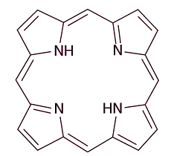
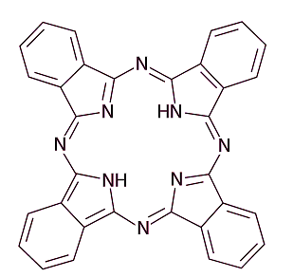
Very important class of luminescent metal complexes, some of which are ubiquitous in nature, are those with planar organic ligands with extensive annular delocalization like the porphyrins and related compounds, the chlorophylls, and the phtalocyanines .
7

Slide 11
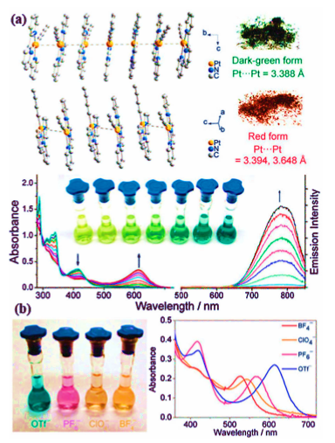
Photoluminescent Pt(II) Complexes
8

Slide 12
Energy level diagram of MOs and possible electronic transitions in a square-planar Pt(II) complex.
d-p MC
d-s MC
MLCT
π -π*
LF or d-d
LMCT
Chem. Soc. Rev., 2013,42, 6128-6185
9

Slide 13
Metal – metal interactions :
(MC) d_{σ*} - p_{σ}
d_{σ*} - π* (MMLCT)
(LLCT) π – π*
Mononuclear
Complex orbitals
Mononuclear
Complex orbitals
Binuclear complex orbitals
Chem. Soc. Rev., 2013,42, 6128-6185
10

Slide 14
Conclusion :
Today luminescence, in its varied forms, is one of the fastest growing and most useful analytical techniques in science that this rapid growth has occurred only in the past couple of decades .The advantages of emission techniques include high sensitivity, good selectivity, environmental qualitative information and multidimensional information.
11

Slide 15
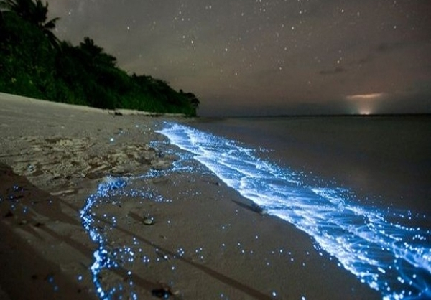
Thanks for your attention

